Slide 1
Exception Handling

Slide 2
Java Error Handling
Java has its roots in embedded systems—software that runs inside specialized devices, such as handheld computers, cellular phones, and fancy toasters that we might consider part of the internet of things (IoT) these days.
In those kinds of applications, it’s especially important that software errors be handled robustly.
Most users would agree that it’s unacceptable for their phone to simply crash or for their toast (and perhaps their house) to burn because their software failed.
Given that we can’t eliminate the possibility of software errors, it’s a step in the right direction to recognize and deal with anticipated application-level errors methodically.

Slide 3
Programmer’s Responsibility
As the programmer, you must know what constitutes a bad result and what it means.
We’ll consider how Java tackles the problem of, well, problems. We’ll go over the notion of exceptions to look at how and why they occur as well as how and where to handle them.
We’ll also be looking at errors and assertions. Errors represent more serious problems that often cannot be fixed at runtime but can still be logged for debugging.
Assertions are a popular way of inoculating your code against exceptions or errors by verifying that safe conditions exist ahead of time.

Slide 4
Exceptions
An exception indicates an unusual condition or an error condition in a code at run time.
Program control becomes unconditionally transferred or “thrown” to a specially designated section of code where that condition is caught and handled.
In this way, error handling is independent of the normal flow of the program.
We don’t need special return values for all of our methods; errors are handled by a separate mechanism.
Control can be passed a long distance from a deeply nested routine and handled in a single location when that is desirable, or an error can be handled immediately at its source.

Slide 5
Exception-Handling Fundamentals
A Java exception is an object that describes an exceptional (that is, error) condition that has occurred in a piece of code.
When an exceptional condition arises, an object representing that exception is created and thrown in the method that caused the error.
That method may choose to handle the exception itself, or pass it on. Either way, at some point, the exception is caught and processed.
Exceptions can be generated by the Java run-time system, or they can be manually generated by your code (for testing) .
Exceptions thrown by Java relate to fundamental errors that violate the rules of the Java language or the constraints of the Java execution environment.

Slide 6
Key Words in Java Exception Handling
Java exception handling is managed via five keywords: try, catch, throw, throws, and finally. Briefly, here is how they work.
Program statements that you want to monitor for exceptions are contained within a try block. If an exception occurs within the try block, it is thrown.
Your code can catch this exception (using catch) and handle it in some rational manner. System-generated exceptions are automatically thrown by the Java run-time system. To manually throw an exception, use the keyword throw.
Any exception that is thrown out of a method must be specified as such by a throws clause.
Any code that absolutely must be executed after a try block completes is put in a finally block.

Slide 7
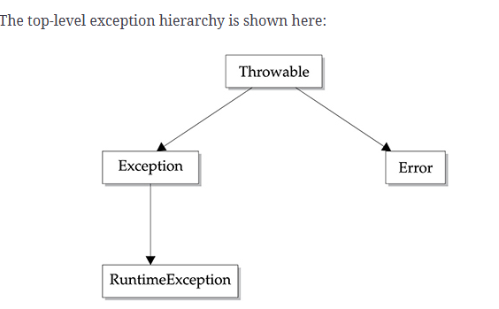
Errors and Exceptions are Throwable
All exception and error types are subclasses of the built-in class throwable.

Slide 8
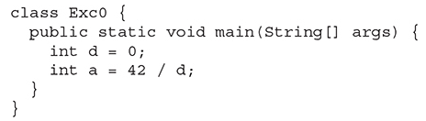

Uncaught Exceptions
Before you learn how to handle exceptions in your program, it is useful to see what happens when you don’t handle them. This small program includes an expression that intentionally causes a divide-by-zero error:
Notice how the class name, Exc0; the method name, main; the filename, Exc0.java; and the line number, 4, are all included in the simple stack trace. Also, notice that the type of exception thrown is a subclass of Exception called ArithmeticException, which more specifically describes what type of error happened.

Slide 9
Exceptions Classes
Exceptions are represented by instances of the class java.lang.Exception and its subclasses.
Subclasses of Exception can hold specialized information (and possibly behavior) for different kinds of exceptional conditions.
However, more often they are simply “logical” subclasses that serve only to identify a new exception type.
Most other packages define their own exception types, which usually are subclasses of Exception itself or of its important subclass RuntimeException.
IOExceptions are the package java.io. Network exceptions belong to the java.net package.
See the list of Exceptions provided by Java ➔

Slide 10
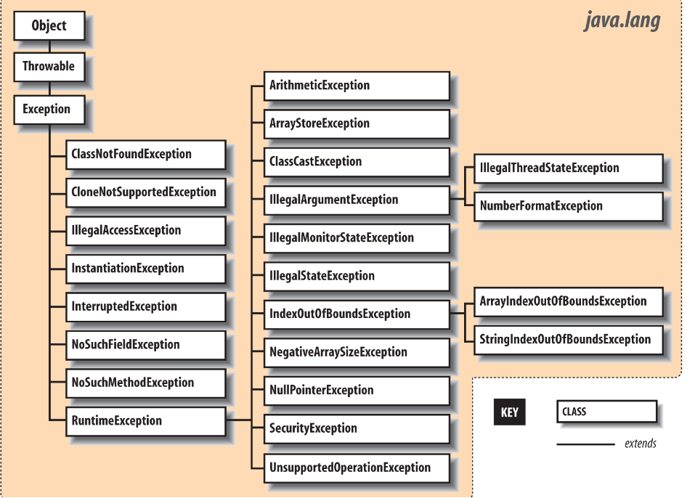

Slide 11
The Exception Object
An Exception object is created by the code at the point where the error condition arises.
It can be designed to hold any information that is necessary to describe the exceptional condition and also includes a full stack trace for debugging.
A stack trace is the (occasionally unwieldy) list of all the methods called and the order in which they were called up to the point where the exception was thrown.
The Exception object is passed as an argument to the handling block of code, along with the flow of control.
This is where the terms throw and catch come from: the Exception object is thrown from one point in the code and caught by the other, where execution resumes.

Slide 12
Java Error Objects
The Java API also defines the java.lang.Error class for unrecoverable errors.
The subclasses of Error in the java.lang package are shown in the next slide.
A few other packages define their own subclasses of Error, but subclasses of Error are much less common (and less useful) than subclasses of Exception.
You generally needn’t worry about these errors in your code (i.e., you do not have to catch them); they are intended to indicate fatal problems or virtual machine errors. An error of this kind usually causes the Java interpreter to display a message and exit.

Slide 13
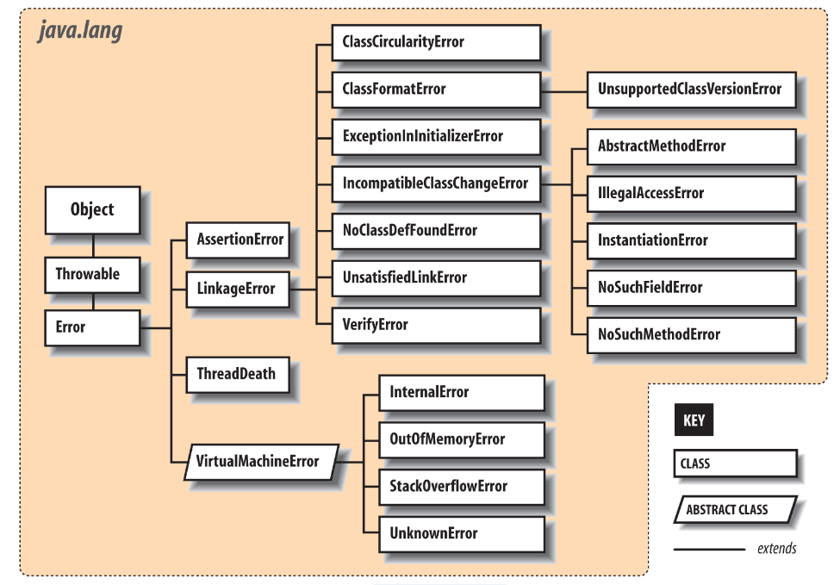

Slide 14
Exception Handling
We can recover from the Exception and continue running the program. This is called exception handling.
Java provides have two tools:
Exception classes
try-catch and finally blocks

Slide 15
try/catch blocks
Exceptions that occur within the body of the try portion of the statement are directed to the catch clause for possible handling.
The catch clause acts like a method; it specifies as an argument the type of exception it wants to handle and if it’s invoked, it receives the Exception object as an argument.
Here, we receive the object in the variable e and print it along with a message.
try {
readFromFile("foo");
...
}
catch ( Exception e ) {
// Handle error
System.out.println( "Exception while reading file: " + e );
...
}

Slide 16
Methods can throw Multiple Exceptions
In that case, we need multiple catch clauses that specify the different type of Exceptions.
The catch clauses are evaluated in order, and the first assignable match is taken.
At most, one catch clause is executed, which means that the exceptions should be listed from most to least specific.
We anticipate that readFromFile() can throw two different kinds of exceptions:
FileNotFoundException
IOException
We catch the parent Exception at the end in case we missed anything. It will catch all other Exceptions.
try {
readFromFile("foo");
...
}
catch ( FileNotFoundException e ) {
// Handle file not found
}
catch ( IOException e ) {
// Handle read error
}
catch ( Exception e ) {
// Handle all other errors
}

Slide 17
Catching the Exception up the Line
If we don’t immediately catch the Exception, it pops up from the method in which it originated and is thrown from that method up to its caller.
If it is not caught there, the exception continues propagating up the call stack, until it is caught or it pops out of the program and crashes it.
It is perfectly fine to catch the exception in a method up the line. It may be that is a more convenient method to handle it.

Slide 18
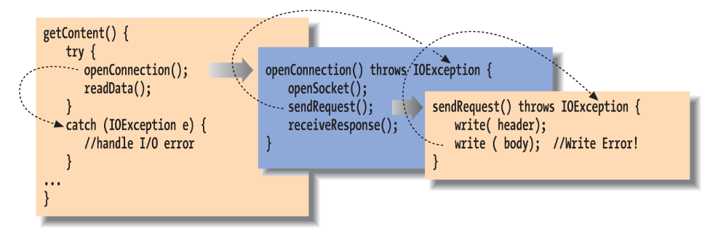
Example: The GetContent Method
The second call to write throws an IOException. There is no try/catch in sendRequest, so it is thrown back to openConnection, which does not have a catch either. Finally, it is caught by the try in getContent and is handled by its catch.

Slide 19
Stack Traces
Because an exception can bubble up quite a distance before it is caught and handled, we may need a way to determine exactly where it was thrown.
It’s also very important to know the context of how the point of the exception was reached; that is, which methods called which methods to get to that point.
For these kinds of debugging and logging purposes, all exceptions can dump a stack trace that lists their method of origin and all the nested method calls it took to arrive there.
Most commonly, the user sees a stack trace when it is printed using the printStackTrace() method.

Slide 20
Getting the StackTrace
try {
// complex, deeply nested task
} catch ( Exception e ) {
// dump information about exactly where the exception occurred
e.printStackTrace( System.err );
}
For example, the stack trace for an exception might look like this:
java.io.FileNotFoundException: myfile.xml
at java.io.FileInputStream.<init>(FileInputStream.java)
at java.io.FileInputStream.<init>(FileInputStream.java)
at MyApplication.loadFile(MyApplication.java:137)
at MyApplication.main(MyApplication.java:5)

Slide 21
How the Read the Trace
This stack trace indicates that the main() method of the class MyApplication called the method loadFile().
The loadFile() method then tried to construct a FileInputStream, which threw the FileNotFoundException.
Note that once the stack trace reaches Java system classes (like FileInputStream), the line numbers may be lost.
This can also happen when the code is optimized by some virtual machines.
Usually, there is a way to disable the optimization temporarily to find the exact line numbers.
However, in tricky situations, changing the timing of the application can affect the problem you’re trying to debug, and other debugging techniques may be required.

Slide 22
More on Using the StackTrace
Methods on the exception allow you to retrieve the stack trace information programmatically as well by using the Throwable getStackTrace() method.
This method returns an array of StackTraceElement objects, each of which represents a method call on the stack.
You can ask a StackTraceElement for details about that method’s location using the methods getFileName(), getClassName(), getMethodName(), and getLineNumber().
Element zero of the array is the top of the stack, the final line of code that caused the exception; subsequent elements step back one method call each until the original main() method is reached.

Slide 23
Checked and Unchecked Exceptions
Java forces us to be explicit about our error handling, but it’s not necessary to require that every conceivable type of error be handled explicitly in every situation.
Java exceptions are therefore divided into two categories: checked and unchecked.
Most application-level exceptions are checked, which means that any method that throws one must declare that it can throw that type of exception in a special throws clause in its method declaration.
Methods have to declare the checked exceptions they can throw or allow to be thrown.
In addition, you must use a try-catch mechanism when calling one of those methods.

Slide 24
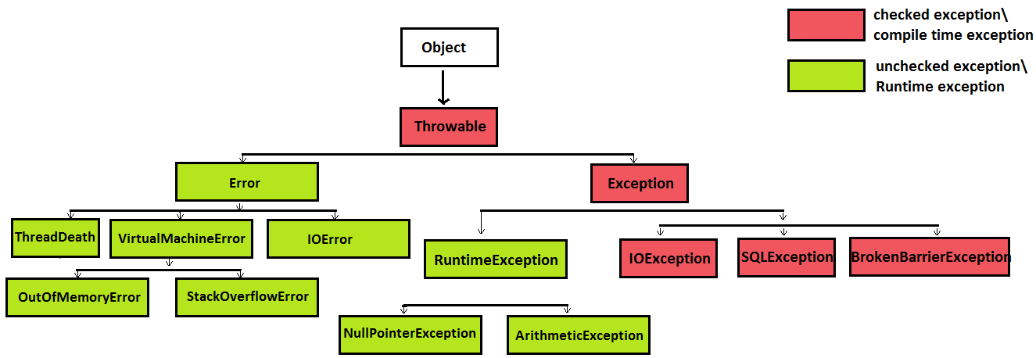
Class Hierarchy for Exception Classes

Slide 25
How Do I Tell if it’s Checked or not?
To find out if a particular exception is checked or unchecked, look up its associated class in the API documentation.
On the class's API page, look at its class hierarchy tree.
If you find that the class is derived from the RuntimeException class or from the Error Exception class, then it's an unchecked exception.
Otherwise, it's a checked exception.

Slide 26
List of Common Unchecked Exceptions
ArithmeticException
NullPointerException
ArrayIndexOutOfBoundsException
NumberFormatException
InputMismatchException
IllegalStateException
Missing Resource Exception
No Such Element Exception

Slide 27
Handling Unchecked Exceptions
Remember, if an unchecked exception is thrown and not caught, then the program will still crash.
How to handle code that might throw an unchecked exception:
1. You can still use a try-catch mechanism
2. Don't attempt to catch the exception, instead write the code carefully to avoid the possibility of the exception being thrown (see the upcoming example).

Slide 28
Careful Coding
The following method attempts to remove a specified student from a list of student names. The list of student names is stored in an ArrayList instance variable named students.
public void removeStudent(int index)
{
students.remove(index);
}
The students.remove method call is dangerous because it throws an unchecked exception, IndexOutOfBoundsException, if its argument holds an invalid index.
How would you take care of that?

Slide 29
Handle the Unchecked Exception
1. Add a line to the removeStudent method and check that the index in NOT out of bounds
public void removeStudent(int index) throws IndexOutOfBoundsException {
if( index < students.size() && index >= 0)
students.remove(index);
}
Question: does this version of the method still throw the Exception?
2. Add a try-catch in the calling method:
try{
studentList.removeStudent(6);
}catch(IndexOutOfBoundsException exc){
System.out.print("Error! " + exc.getMessage());
}

Slide 30
Throwing Exceptions
We can throw our own exceptions—either instances of Exception, one of its existing subclasses, or our own specialized exception classes.
All we have to do is create an instance of the Exception and throw it with the throw statement:
throw new IOException();
Execution stops and is transferred to the nearest enclosing try/catch statement that can handle the exception type. An alternative constructor lets us specify a string with an error message:
throw new IOException("Sunspots!");

Slide 31
Getting Information from the Exception Object
You can retrieve the error string by using the Exception object’s getMessage() method.
Often, though, you can just print (or toString()) the exception object itself to get the message and stack trace.
By convention, all types of Exception have a String constructor like this.
The preceding String message is not very useful.
Normally, it will throw a more specific subclass Exception, which captures details or at least a more specific string explanation.

Slide 32
Example: Method to Check for an Illegal Path
public void checkRead( String s ) {
if ( new File(s).isAbsolute() || (s.indexOf("..") != -1) )
throw new SecurityException(
"Access to file : "+ s +" denied.");
}
In this code, we partially implement a method to check for an illegal path. If we find one, we throw a SecurityException along with some information about the transgression.

Slide 33
A Custom Exception
Of course, we could include any other information that is useful in our own specialized subclasses of Exception.
Often, though, just having a new type of exception is good enough because it’s sufficient to help direct the flow of control.
For example, if we are building a parser, we might want to make our own kind of exception to indicate a particular kind of failure.

Slide 34
The Example Code
class ParseException extends Exception {
private int lineNumber;
ParseException() {
super();
this.lineNumber = -1;
}
ParseException( String desc, int lineNumber ) {
super( desc );
this.lineNumber = lineNumber;
}
public int getLineNumber() {
return lineNumber;
}
}

Slide 35
Use a try/catch with the Custom Exception
// Somewhere in our code
...
try {
parseStream( input );
} catch ( ParseException pe ) {
// Bad input...
// We can even tell them which line was bad!
} catch ( IOException ioe ) {
// Low-level communications problem
}
Even without the special information like the line number where our input caused a problem, our custom exception lets us distinguish a parse error from an arbitrary I/O error in the same chunk of code.

Slide 36
Chaining And Rethrowing Exceptions
Sometimes you’ll want to take some action based on an exception and then turn around and throw a new exception in its place.
This is common when building frameworks where low-level detailed exceptions are handled and represented by higher-level exceptions that can be managed more easily.
For example, you might want to catch an IOException in a communications package, possibly perform some cleanup, and ultimately throw a higher-level exception of your own, maybe something like LostServerConnection.

Slide 37
Exception Chaining
You can do this in the obvious way by simply catching the exception and then throwing a new one, but then you lose important information, including the stack trace of the original “causal” exception.
To deal with this, you can use the technique of exception chaining. This means that you include the causal exception in the new exception that you throw.
Java has explicit support for exception chaining.
The base Exception class can be constructed with an exception as an argument or the standard String message and an exception:
throw new Exception( "Here's the story...", causalException );

Slide 38
Access to the Causal Exception
You can get access to the wrapped exception later with the getCause() method.
Java automatically prints both exceptions and their respective stack traces if you print the exception or if it is shown to the user.
You can add this kind of constructor to your own exception subclasses or you can take advantage of this pattern by using the Throwable method initCause() to set the causal exception explicitly.
The initCause () method of Java Throwable class is used to initialize the cause of the this Throwable with the specified cause passed as a parameter to initCause. This method can be called only once.

Slide 39
Using initCase() from the Throwable class
try {
// ...
} catch ( IOException cause ) {
Exception e =
new IOException("What we have here is a failure to communicate...");
e.initCause( cause );
throw e;
}

Slide 40
Narrowed Rethrow
Java allows us to narrow the type of exceptions thrown back to the original types in most cases. An example:
void myMethod() throws ZipException, SSLException
{
try {
// Possible cause of ZipException or SSLException
} catch ( Exception e ) {
log( e );
throw e;
}
}

Slide 41
Using the catch Exception
In this example, we are exceedingly lazy and simply catch all exceptions with a broad catch Exception clause in order to log them prior to rethrowing.
The Java compiler is now smart enough in most cases to analyze the actual types of exceptions that may be thrown and allows us to prescribe the precise set of types.
The same would be true if we had used the mutiple-type catch clause in this example, as you might have guessed.
The preceding is a bit less intuitive, but very useful in shoring up the specificity of exception handling of code without requiring potentially tricky reworking of catch clauses.

Slide 42
try creep
The try statement imposes a condition on the statements that it guards.
It says that if an exception occurs within it, the remaining statements are abandoned.
This has consequences for local variable initialization.
The JVM knows that statements inside a try block might possibly be skipped, and it assumes the worst, that all statements inside a try block get skipped.
So it insists that the local variable be initialize outside the try block. Rather forcefully.

Slide 43
Example:
void myMethod() {
int foo;
try {
foo = getResults();
}
catch ( Exception e ) {
...
}
int bar = foo; // Compile-time error: foo may not have been initialized
In this example, we can’t use foo in the indicated place because there’s a chance it was never assigned a value.

Slide 44
One obvious option is to move the assignment inside the try statement:
try {
foo = getResults();
int bar = foo; // Okay because we get here only
// if previous assignment succeeds
}
catch ( Exception e ) {
...
}
The compiler is smart enough to know that if an error had occurred in the try clause, we wouldn’t have reached the bar assignment, so it allows us to refer to foo.

Slide 45
The Finally Clause
What if we have something important to do before we exit our method from one of the catch clauses?
To avoid duplicating the code in each catch branch and to make the cleanup more explicit, you can use the finally clause.
A finally clause can be added after a try and any associated catch clauses.
Any statements in the body of the finally clause are guaranteed to be executed no matter how control leaves the try body, whether an exception was thrown or not.
try {
// Do something here
}
catch ( Exception e ) {
...
}
finally {
// Cleanup here is always executed
}

Slide 46
try with Resources
A common use of the finally clause is to ensure that resources used in a try clause are cleaned up, no matter how the code exits the block.
That means to deallocate expensive resources or close connections such as files, sockets, or database connections.
In some cases, these resources might get cleaned up on their own eventually as Java reclaims the garbage, but that would at best be at an unknown time in the future and at worst may never happen or may not happen before you run out of resources.
So it is always best to guard against these situations.
There are two problems with this approach:
It requires extra work to carry out this pattern in all of your code, including important things like null checks, as shown in our example.
If you are juggling multiple resources in a single finally block, you have the possibility of your cleanup code throwing an exception (e.g., on close()) and leaving the job unfinished.

Slide 47
Enter “try with resources”
Since Java 7, we have had the new “try with resources” form of the try clause.
In this form, you may place one or more resource initialization statements within parentheses after a try keyword, and those resources will automatically be “closed” for you when control leaves the try block.
In this example, we initialize both a Socket object and a FileWriter object within the try-with-resources clause and use them within the body of the try statement.
When control leaves the try statement, either after successful completion or via an exception, both resources are automatically closed by calling their close() method.

Slide 48
Example of try with resources
try (
Socket sock = new Socket("128.252.120.1", 80);
FileWriter file = new FileWriter("foo");
)
{
// work with sock and file
} catch ( IOException e ) {
...
}

Slide 49
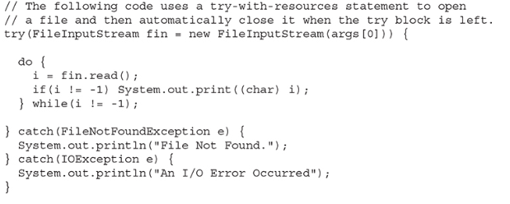
Another Example of Try with Resources

Slide 50
Discussion
Notice how the resource-specification portion of the try declares a FileInputStream called fin, which is then assigned a reference to the file opened by its constructor.
Thus, the variable fin is local to the try block, being created when the try is entered.
When the try is left, the stream associated with fin is automatically closed by an implicit call to close( ). You don’t need to call close( ) explicitly.This is a key advantage of using try-with-resources.
It is important to understand that a resource declared in the try statement is implicitly final. This means that you can’t assign to the resource after it has been created.
Also, the scope of the resource is limited to the try-with-resources statement.

Slide 51
The AutoCloseable Interface
Resources are closed in the reverse of the order in which they were constructed, so dependencies among them can be accommodated.
This behavior is supported for any class that implements the AutoCloseable interface.
The close() method of this interface is prescribed to release all resources associated with the object, and you can implement this easily in your own classes as well.
When using try with resources, we don’t have to add any code specifically to close the file or socket; it is done for us automatically.

Slide 52
Exception thrown during a close() Operation
Another problem that try with resources solves is the pesky situation where an exception may be thrown during a close operation.
Looking back to the prior example in which we used a finally clause to do our cleanup, if an exception had been raised by the close() method, it would have been thrown at that point, completely abandoning the original exception from the body of the try clause.
But in using try with resources, we preserve the original exception.
If an exception occurs while within the body of the try and one or more exceptions is raised during the subsequent auto-closing operations, it is the original exception from the body of the try that is bubbled up to the caller.

Slide 53
Example with Sockets and Files using try with resources
try (
Socket sock = new Socket("128.252.120.1", 80); // potential exception #3
FileWriter file = new FileWriter("foo"); // potential exception #2
)
{
// work with sock and file // potential exception #1
}

Slide 54
What Happens
Once the try has begun, if an exception occurs as exception point #1, Java will attempt to close both resources in reverse order, leading to potential exceptions at locations #2 and #3.
In this case, the calling code will still receive exception #1.
Exceptions #2 and #3 are not lost, however; they are merely “suppressed” and can be retrieved via the Throwable getSuppressed() method of the exception thrown to the caller.
This returns an array of all of the supressed exceptions.

Slide 55
Performance Issues
Because of the way the Java VM is implemented, guarding against an exception being thrown (using a try) is free.
It doesn’t add any overhead to the execution of your code. However, throwing an exception is not free.
When an exception is thrown, Java has to locate the appropriate try/catch block and perform other time-consuming activities at runtime.
The result is that you should throw exceptions only in truly “exceptional” circumstances and avoid using them for expected conditions, especially when performance is an issue.

Slide 56
Try to avoid throwing Frequent Exceptions
For example, if you have a loop, it may be better to perform a small test on each pass and avoid throwing the exception rather than throwing it frequently.
On the other hand, if the exception is thrown only once in a gazillion times, you may want to eliminate the overhead of the test code and not worry about the cost of throwing that exception.
The general rule should be that exceptions are used for “out of bounds” or abnormal situations, not routine and expected conditions (such as the end of a file).
Remember that you can take care of most unchecked exceptions using careful coding. There is no cost to that!

